Slide 1
Omni-Channel Optimization
Presenter Name
Notes:
Information in this document, including URL and other Internet Web site references, is subject to change without notice. Unless otherwise noted, the example companies, organizations, products, domain names, e-mail addresses, logos, people, places, and events depicted herein are fictitious, and no association with any real company, organization, product, domain name, e-mail address, logo, person, place or event is intended or should be inferred. Complying with all applicable copyright laws is the responsibility of the user. Without limiting the rights under copyright, no part of this document may be reproduced, stored in or introduced into a retrieval system, or transmitted in any form or by any means (electronic, mechanical, photocopying, recording, or otherwise), or for any purpose, without the express written permission of Microsoft Corporation.
Microsoft may have patents, patent applications, trademarks, copyrights, or other intellectual property rights covering subject matter in this document. Except as expressly provided in any written license agreement from Microsoft, the furnishing of this document does not give you any license to these patents, trademarks, copyrights, or other intellectual property.
The names of manufacturers, products, or URLs are provided for informational purposes only and Microsoft makes no representations and warranties, either expressed, implied, or statutory, regarding these manufacturers or the use of the products with any Microsoft technologies. The inclusion of a manufacturer or product does not imply endorsement of Microsoft of the manufacturer or product. Links may be provided to third party sites. Such sites are not under the control of Microsoft and Microsoft is not responsible for the contents of any linked site or any link contained in a linked site, or any changes or updates to such sites. Microsoft is not responsible for webcasting or any other form of transmission received from any linked site. Microsoft is providing these links to you only as a convenience, and the inclusion of any link does not imply endorsement of Microsoft of the site or the products contained therein.
© 2017 Microsoft Corporation. All rights reserved.
Microsoft and the trademarks listed at https://www.microsoft.com/en-us/legal/intellectualproperty/Trademarks/Usage/General.aspx are trademarks of the Microsoft group of companies. All other trademarks are property of their respective owners.
August 2020

Slide 2
Abstract and learning objectives
In the whiteboard design session, you will work in groups to design a solution that should provide a vision that allows the audience (the Chief Marketing Officer, Chief Digital Officer, the Chief Data Officer, and the Customer Experience Manager) to understand how using this solution will give the information that is needed to deliver the Omni-Channel optimized solution
At the end of the whiteboard design session, you will be better able to design a solution that leverages various application and data services within Azure for an end-to-end Omni-channel optimized architecture.

Slide 3
Step 1: Review the customer case study
Outcome
Analyze your customer needs.
Timeframe
15 minutes

Slide 4
Customer abstract
Parts Unlimited, a subsidiary of Fabrikam Retail INC., has been feeling some pain and would like your help to redesign and implement some new solutions to be able to better compete in the current marketplace. Among the main problems that Parts Unlimited is facing are
* Lack of connection between online and in-store data leading to an inability to provide a selection optimization that is tailored to a specific customer
* Inconsistent pricing, promotion, product availability, and fulfillment strategies exist across their various channels
* Customers are not completing orders due to redundant steps in the shopping journey, and encountering irrelevant interactions with the system
* Currently, Parts Unlimited is unable to address latent customer needs
* Parts Unlimited is unable to deliver an engaging and compelling experience to their customers regardless of platform or location.
* Customer experiences vary when shopping across channels, including having fragmented and inconsistent experiences.
* Parts Unlimited currently is unable to maximize the effectiveness of their workforce.

Slide 5
Customer abstract continued
Parts Unlimited is asking you to deliver a solution that will allow their customers to experience a smooth and relevant experience, regardless of the platform, device, and/or channel from which they are shopping. Of great importance is the ability to deliver dynamic and rich content that includes augmented and mixed-reality experiences. Furthermore, customer data should be used to present relevant shopping experiences and product consistency to delight their customers.
Parts Unlimited wants to ensure that they have maximized their ad spend for increased ROI and increased revenue. Additionally, Parts Unlimited wants their customers to have an engaging experience that is similar on all digital channels and in their brick-and-mortar stores.
An additional piece of information Parts Unlimited would like is the ability to be able to optimize the utilization and effectiveness of their workforce.
In the end, the solution should provide a vision that allows the audience (the Chief Marketing Officer, Chief Digital Officer, the Chief Data Officer, and the Customer Experience Manager) to understand how using this solution will give the information that is needed to deliver the Omni-Channel optimized solution.

Slide 6
Customer situation
Parts Unlimited Retail, Inc has been selling goods through various retail channels for the past 15 years. As various platforms and technologies have evolved, Parts Unlimited has struggled to keep up, but has done the best they could to continue to provide solutions for their customers.
Currently, they have just over 200 brick-and-mortar stores but are planning to close 50+ of these stores next year, taking the number of physical locations down to 150 stores due to declining revenue and various other factors. Of the remaining 150 stores, 35 of them are currently streamlined for an attempted re-branding that happened a few years ago. The re-branded stores were chosen based on population bases of less than 50,000 in an 200 square mile radius or within 50 miles of a major metropolitan area. These rebranded "Parts Unlimited Hometown" stores eliminated most of the non-essential retail, such as sporting and workout equipment, and focused in on essentials like appliances, automotive, and kept a limited selection of electronics, only offering about 15% of the options for items like UHD televisions, antennas, and blu-ray players. Customers have expressed frustrations when an advertisement in the local newspaper for Parts Unlimited included a great deal on a large-screen television only to find they have to order online or drive to the larger store in a city that is sometimes located over 50 miles away. While it is clear that customers are not pleased with this solution, it is not clear if this is an effective strategy to save the company when it comes to providing a simplified retail option.

Slide 7
Customer situation continued
In addition to re-branding efforts, in the past few years attempts have been made to enhance the web app for responsive delivery and a couple of apps were also built to specifically target IOS and Android devices. Unfortunately, the data from these applications and the web solution is not connected, and when a user switches devices or goes from a device to the web, the experience is not uniform, leading to confusion and frustration. Questions such as "why isn't the item I selected on my phone in my cart when I go to the website?" are far too common.
Parts Unlimited needs an ability to collect and analyze all of this data in order to make the best uniform solution possible. The solution needs to allow for a user to be able to walk into a brick-and-mortar store and get the items they are looking for, or to be able to switch from any device to the web or from the web to a device and get a streamlined experience. Finally, the customer needs to leave the shopping experience as an advocate for the company, having been delivered an experience that they would recommend to others.

Slide 8
Current process
Parts Unlimited currently has over 200 brick-and-mortar stores, with 50+ stores closing and 35 stores running the re-branded profile. Some stores have a pre-determined, limited selection and a limited inventory of the products they do offer.
Parts Unlimited has an MVC website written in the .Net Framework and has been previously upgraded to version 4.7.2. The website is supposed to be responsive, as it utilized Bootstrap for responsive layout, but the site is currently not able to work on a few devices due to some styling problems.
In addition to the website, Parts Unlimited has an Android application written in native Java that is three versions behind the current version of Android, but has been upgraded enough to continue to work on newer devices, even though it does not necessarily leverage all of the features of newer devices.
Along with the website and android app, a third app written in Swift is available for use on the Apple IOS devices.
All applications and sites do work, but the user experience, including sign-on, shopping cart, and other factors is unique to each platform. For example, a user must sign in on the website and then sign in again on the device, and the shopping cart is not shared across devices, so items added to the cart on the web do not show up on the phone, or vice-versa.
As a struggling retailer, Parts Unlimited has a limited amount of resources to apply to getting the entire experience upgraded, so they need you to come up with the best, cost-effective solution.

Slide 9
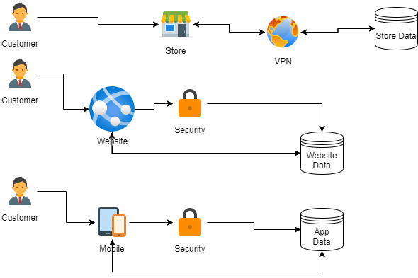
Current Process diagram

Slide 10
Customer Needs
1. Deliver a seamless experience to the user, regardless of platform, device, or location (online or at brick-and-mortar traditional stores)
2. Use customer data to deliver a relevant shopping experience.
3. Provide a customer experience on any delivery that provides dynamic and rich content.
4. Present relevant and consistent product information to the customers, including using customer data to choose relevant products, remove any redundant or unnecessary interactions. Make the customer feel unique and valued through the experience.
5. Ensure that pricing, promotions, product availability are all consistent and easy to manage so that the experience is the same on all channels.
6. Respond to customer needs, including the ability to fulfil latent customer needs.

Slide 11
Customer objections
1. We're pretty much in survival mode at this point. We're just not sure that the ROI on this project will be enough to justify the risk.
2. With our current situation, we are very limited on budget and team members. We're just not sure we'll have the resources to implement and support this solution.
3. It will be too difficult to use analytics/nobody really understands analytics so we'll just end up with a lot of data that we can't use.
4. Our upper management is very difficult to work with and they don't like changing technology. Getting all of this approved and implemented is going to be too difficult.

Slide 12
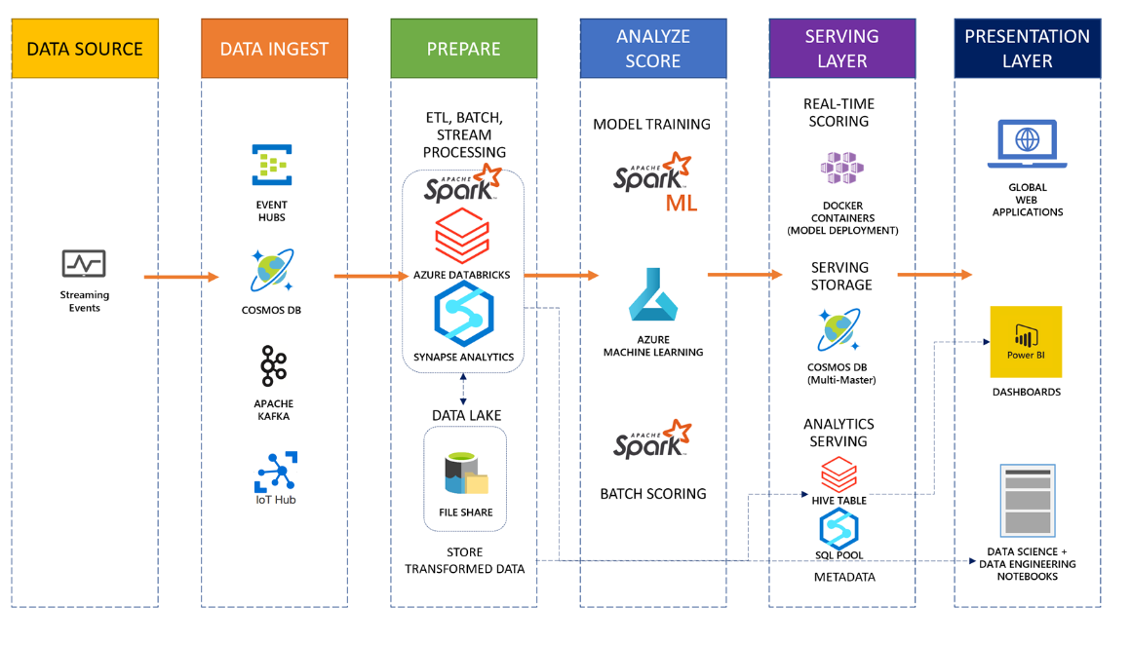
Common scenario

Slide 13
Step 2: Design the solution
Outcome
Design a solution and prepare to present the solution to the target customer audience in a 15-minute chalk-talk format.
Timeframe
60 minutes
Business needs (10 minutes) | Respond to questions outlined in your guide and list the answers on a digital Whiteboard.
Design (35 minutes) | Design a solution for as many of the stated requirements as time allows. Show the solution on a Whiteboard.
Prepare (15 minutes) | Identify any customer needs that are not addressed with the proposed solution. Identify the benefits of your solution. Determine how you will respond to the customer’s objections. Prepare for a 15-minute presentation to the customer.

Slide 14
Step 3: Present the solution
Outcome
Present a solution to the target customer in a 15-minute chalk-talk format.
Timeframe
30 minutes (15 minutes for each team to present and receive feedback)
Directions
Pair with another table.
One table is the Microsoft team and the other table is the customer.
The Microsoft team presents their proposed solution to the customer.
The customer asks one of the objections from the list of objections in the case study.
The Microsoft team responds to the objection.
The customer team gives feedback to the Microsoft team.

Slide 15
Wrap-up
Outcome
Identify the preferred solution for the case study.
Identify solutions designed by other teams.
Timeframe
15 minutes

Slide 16
Omni-Channel Optimization
Whiteboard Design Session – Preferred Solution

Slide 17
High Level Architecture
The preferred solution includes ingestion of data into Azure Data Factory, then processing that data into Dat Lake Storage and then using Databricks and Azure Synapse Services and Analysis services, prepare the data for presentation into Power BI.

Slide 18
Data Ingestion
The current solution does get data into a number of databases, but the data is incomplete and not able to be easily used. The first part of the process will be to get the data ingested - to bring it into a state where it is ready to be used by the rest of the process. By ingesting the data using Azure Data Factory, you can get the data and transform it if necessary. In the end, you'll have a complete picture of your data ready to go for the next parts of the process.

Slide 19
Data Pipeline Processing
As part of the ingestion and transformation process, you may find reason to process the data and transform it as you ingest it. By doing the transformation of the original data, you can position the data store to have information ready to go.
While you may do some original transformation of the data, it is also likely that in order to present the final solution you will need to further transform the data that has been previously ingested.
Databricks allows you to use SQL queries against your Datalake to get your data ready to present.

Slide 20
Dashboards and Reporting
It doesn't matter how good your data ingestion and transformation is if you never present the results to the appropriate audience. Using dashboards and other reports, you can use the ingested, transformed, and extracted data to present valuable information to the business decision makers.

Slide 21
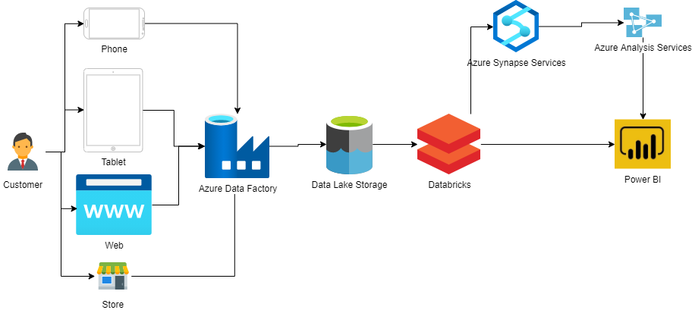
Preferred Solution Architecture diagram

Slide 22
Preferred objections handling #1
Objection
We're pretty much in survival mode at this point. We're just not sure that the ROI on this project will be enough to justify the risk.
Potential answer
Currently, your system is working, but you are losing revenue and customers due to solutions that are not easy to use and an inability to provide the user with a streamlined solution. We are confident that implementing an omni-channel solution will provide ROI through keeping your current customers happy, helping you to drive more sales revenue by both allowing the user to find products to buy but also by presenting products that are relevant to the customer.

Slide 23
Preferred objections handling #2
Objection
With our current situation, we are very limited on budget and team members. We're just not sure we'll have the resources to implement and support this solution.
Potential answer
Every new implementation does come with a cost. As your systems are aging and not able to keep up with your current competitors, you have to make the choice to continue to fade or to take action to set you apart and allow your business to be relevant.

Slide 24
Preferred objections handling #3
Objection
It will be too difficult to use analytics/nobody really understands analytics so we'll just end up with a lot of data that we can't use.
Potential answer
As you'll see in a bit, a lot of the work is already going to be done for you. You will have your data pipeline built out in a way to transform the data for presentation, and you'll put dashboards on top of that. Your team will not likely need to do much more than read some charts and understand how to use the dashboard. In some cases, the team may desire deeper results. Through this proposed solution, your team can easily write queries to get those results in a language that they likely already know.

Slide 25
Preferred objections handling #4
Objection
Our upper management is very difficult to work with and they don't like changing technology. Getting all of this approved and implemented is going to be too difficult.
Potential answer
Your upper management is likely very interested in learning about how this implementation will help you achieve the objectives of getting ROI and retaining customers while attracting new ones. Additionally, your upper management should be made aware that by building this foundation, you'll have a faster path to success on future projects of a similar nature.

Slide 26
Preferred objections handling #5
Objection
We really don't have a lot of time to spend training our people. We can't afford to learn a whole new query language.
Potential answer
The great news here is that using Azure Databricks, the users that already know how to write SQL queries will be able to use their existing skills to get the data that they need.
Additionally, with Databricks, you can easily set up the ability to read from your data lake and use tools like Spark to provide insights.

Slide 27
Customer Quote
"We are so pleased with the results offered through the provided solution. Our analysts and marketing team are now able to get valuable insight on the data they need in order to make the informed decisions they need to drive our retail business to success while providing our customers a superior experience."
- Guy Information, CIO, Parts Unlimited Retail

